Slide 1
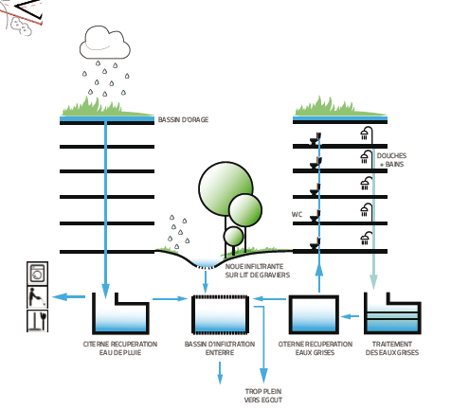
Water treatment: 0% waste

